Slide 1


Investigating the Shooting-Free Weekend in New York City: Consequence or Coincidence?
Rachel Weber
Practice Presentation April 2020

Slide 2
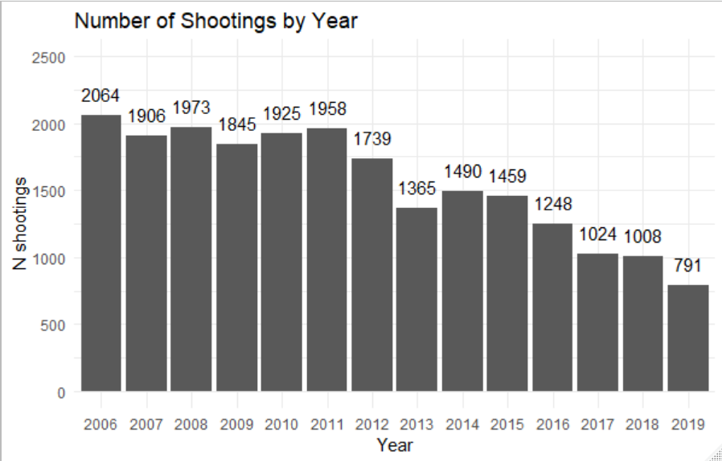
Introduction
NYC has had a steady decline in shootings over the past 12 years
In 2018, NYC had their first shooting-free weekend in decades
Was this a miraculous event or was it reasonably expected?
Notes:
Reasonably expected meaning given enough weekends and the changes to NYC gun violence rates, the probability of a weekend being shooting-free is no longer miniscule. I don’t define miniscule here but given New York’s tumultuous past with gun violence, a probability above 1% would be sizable.
One of the things that has changed significantly in this time is….

Slide 3
Introduction
SAFE Act
NYC has had a steady decline in shootings over the past 12 years
In 2018, NYC had their first shooting-free weekend in 25 years.
Was this a miraculous event or was it reasonably expected?
The SAFE Act was passed in January 2013. Did this have a measurable impact on gun violence?
Notes:
Recall that Sandy Hook happened in December 2012.
SAFE Act is comprehensive gun legislation that among other things includes broader definitions of ‘assault style weapons’, prohibitions on high capacity magazines, mandated background checks, and safe storage provisions

Slide 4
Aims and Hypotheses
Aim 1: Build an interrupted time series negative binomial model to predict the number of shootings expected on a given day
Hypothesis 1: Day of the week is a significant predictor of the number of shootings estimated to occur
Hypothesis 2: SAFE Act passage decreased the total number of expected shootings in a day.
Aim 2: Build an interrupted time series negative binomial model to predict the number of shootings expected in a month
Hypothesis 3: SAFE Act passage decreased the number of expected shootings in a month
Notes:
This 3rd hypothesis may seem redundant but can be informative for two reasons:
Change from SAFE act at daily level may be miniscule/too difficult to measure
Change at monthly level may be more informative for public health officials

Slide 5
The Data
NYC’s Open Data program provides downloadable files documenting each shooting that occurs in the city’s boundaries.
Contained in the data:
Date and time of shooting
Location (precinct, longitude, latitude, burrow)
Shooter/victim demographics
Data span 2006 to 2019 and are updated quarterly
Notes:
The most shootings to occur in a day were 30. The least were 0. There were a little over 5000 days in this data set. 387 days were shooting-free. This is about 8% of days.

Slide 6
Interrupted Time Series
N Shootings
Time

Slide 7
Interrupted Time Series
“Baseline” Change over time
N Shootings
Time

Slide 8
Interrupted Time Series
“Baseline” Change over time
N Shootings
New Slope
Time
Notes:
This single event changed the rate at which shootings were changing over time.
In the final model, you interpret a variable for that moment (everything pre- and everything post-)
AND
You interpret a variable for the new slope
If the event you’re studying didn’t really make a difference, one or both of these variables will not be significant.

Slide 9
Interrupted Time Series
“Baseline” Change over time
N Shootings
New Slope
Time
Notes:
This single event changed the rate at which shootings were changing over time.
In the final model, you interpret a variable for that moment (everything pre- and everything post-)
AND
You interpret a variable for the new slope
If the event you’re studying didn’t really make a difference, one or both of these variables will not be significant.

Slide 10
Methods
Variable Creation: Month, Year, Pre-Post SAFE Act, and Day of the Week
Univariate Analysis
Negative Binomial Regression with Interrupted Time Series at Day level
Negative Binomial Regression with Interrupted Time Series at Month Level
Interpretation and Prediction

Slide 11
Estimate table
Variable | Estimate | P-Value | 95% Confidence Interval
Intercept | 3.88 | <.001 | (3.53, 4.28)
Baseline Slope | 0.98 | 0.009 | (0.97,1)
Day (Monday) | 1.06 | 0.133 | (0.98, 1.14)
Day (Tuesday) | 0.86 | <.001 | (0.8, 0.93)
Day (Wednesday) | 0.82 | <.001 | (0.76, 0.88)
Day (Thursday) | 0.81 | <.001 | (0.75, 0.87)
Day (Saturday) | 1.44 | <.001 | (1.35, 1.55)
Day (Sunday) | 1.53 | <.001 | (1.42, 1.64)
Pre-Post SAFE Act | 0.86 | <.001 | (0.8, 0.93)
Intervention Slope Change | 0.94 | <.001 | (0.92, 0.96)
Month (February) | 0.85 | 0.002 | (0.77, 0.94)
Month (March) | 0.95 | 0.291 | (0.86, 1.05)
Month (April) | 1.16 | 0.003 | (1.05, 1.28)
Month (May) | 1.46 | <.001 | (1.32, 1.6)
Month (June) | 1.61 | <.001 | (1.47, 1.77)
Month (July) | 1.76 | <.001 | (1.61, 1.93)
Month (August) | 1.76 | <.001 | (1.6, 1.92)
Month (September) | 1.5 | <.001 | (1.37, 1.65)
Month (October) | 1.35 | <.001 | (1.22, 1.48)
Month (November) | 1.17 | 0.002 | (1.06, 1.29)
Month (December) | 1.17 | 0.001 | (1.06, 1.29)
Notes:
Slide hidden from presentation

Slide 12
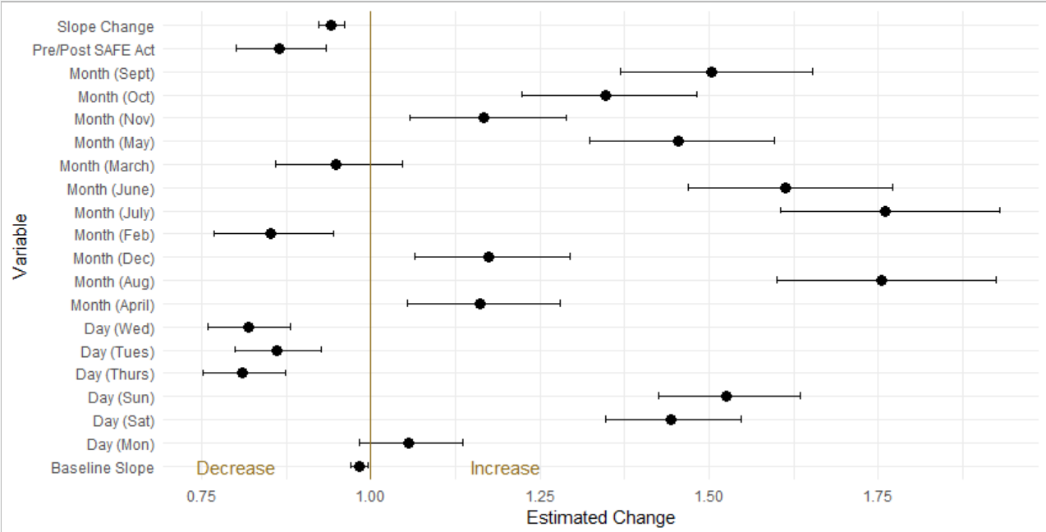
Results: Day Level
Intercept: 3.8 shootings per day
Notes:
Very bottom is our baseline slope
At the very top is our change in slope
And we include month, day and pre-post SAFE Act to predict number of shootings per day
Our intercept was 3.8 which is our expected number of shootings on a Friday in January, pre-SAFE Act passage
These covariates are interpreted similarly to how we interpret those in logistics regression.
A covariate of 1 means the variable makes no change on our expected number of shootings per day.
Below 1 represents a percent decrease in expectation and above 1 is a percent increase in expectation

Slide 13
Results: Day Level
Intercept: 3.8 shootings per day
Notes:
To answer hypothesis 1: Day of the week is a significant predictor of shooting incidence, though not all days were significant in this model.
Tuesday, Wednesday, Thursday had lower expected shootings than Friday and Saturday, Sunday had higher.

Slide 14
Results: Day Level
Intercept: 3.8 shootings per day
Notes:
To address hypothesis 2: SAFE Act Passage lowered our expected number of shootings per day.
We estimate a change of about 14%.
A Friday in January is now estimate to have about 3.3 shootings.

Slide 15
Estimate Table
Variable | Estimate | P-Value | 95% CI
Intercept | 312.67 | <.001 | (121.31, 145.09)
Baseline Slope | 0.999 | 0.028 | (1,1)
Pre-Post SAFE Act | 0.875 | 0.002 | (0.8, 0.95)
Slope Change | 0.995 | <.001 | (0.99, 1)
Month (February) | 0.792 | <.001 | (0.71, 0.88)
Month (March) | 0.947 | 0.312 | (0.85, 1.05)
Month (April) | 1.105 | 0.061 | (1, 1.23)
Month (May) | 1.416 | <.001 | (1.28, 1.57)
Month (June) | 1.529 | <.001 | (1.38, 1.69)
Month (July) | 1.71 | <.001 | (1.55, 1.89)
Month (August) | 1.718 | <.001 | (1.55, 1.9)
Month (September) | 1.421 | <.001 | (1.28, 1.57)
Month (October) | 1.314 | <.001 | (1.18, 1.46)
Month (November) | 1.113 | 0.049 | (1, 1.24)
Month (December) | 1.158 | 0.007 | (1.04, 1.29)
Notes:
Slide hidden from presentation

Slide 16
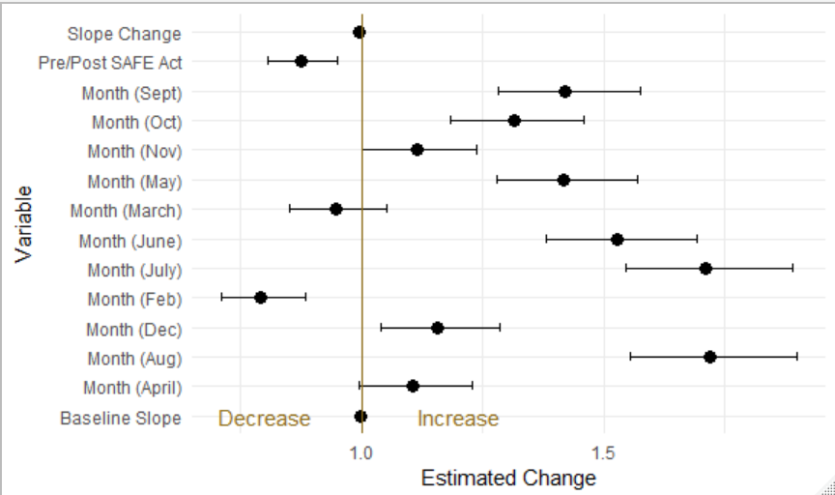
Results: Month Level
Intercept: 132.7 shootings per month
Notes:
Our intercept represents a January pre-SAFE act passage.
July and August increase estimates by 71%
February is associated with a 21% decrease in shootings

Slide 17
Results: Month Level
Intercept: 132.7 shootings per month
Notes:
To address our final hypothesis: SAFE Act passage did significantly impact our estimates for monthly shootings.
A January pre-SAFE act was estimated to have 132.7 shootings. After SAFE Act passage, January is estimated to have 13% fewer shootings. Which is about 115.5 shootings.

Slide 18
Model Limitations
I did not account for other, small scale interventions that happened in NYC
Changes in Policing
Cure Violence Program
Models assume that the number of shootings in a day or month are independent of those that occurred previously
Likely not true but model complexity and intervention interpretation become much more difficult with a conditional structure.
Notes:
Nonetheless, our standard errors and resulting confidence intervals suggest that the variables we use are very informative in the model.

Slide 19
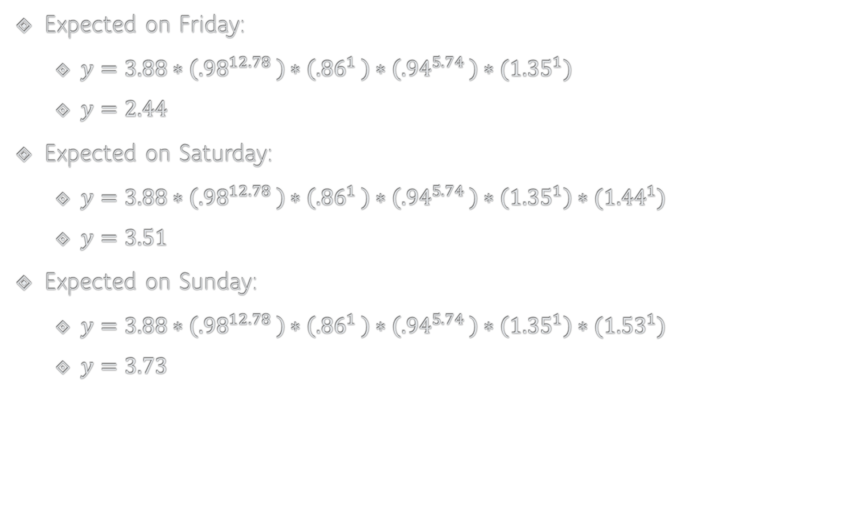
What did we expect that weekend in October 2018?
Expected on Friday:
$y=3.88∗\left({.98}^{12.78}\right)∗\left({.86}^{1}\right)∗\left({.94}^{5.74}\right)∗({1.35}^{1})$
$y=2.44$
Expected on Saturday:
$y=3.88∗\left({.98}^{12.78}\right)∗\left({.86}^{1}\right)∗\left({.94}^{5.74}\right)∗\left({1.35}^{1}\right)∗({1.44}^{1})$
$y=3.51$
Expected on Sunday:
$y=3.88∗\left({.98}^{12.78}\right)∗\left({.86}^{1}\right)∗\left({.94}^{5.74}\right)∗\left({1.35}^{1}\right)∗({1.53}^{1})$
$y=3.73$
10
Shootings

Slide 20
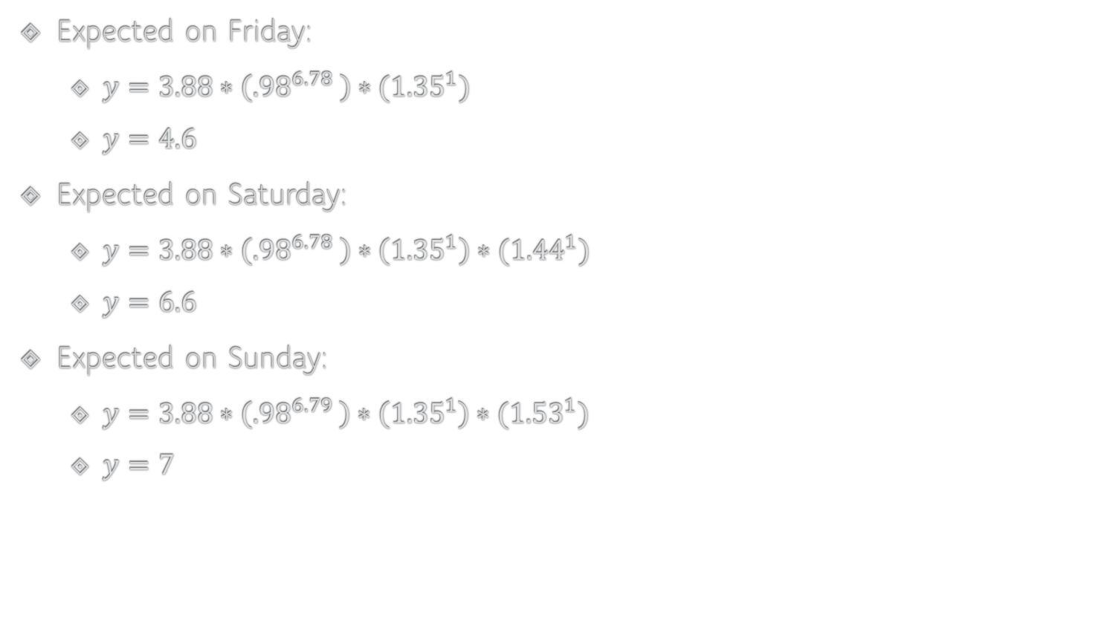
How does that compare to October 2012?
Expected on Friday:
$y=3.88∗\left({.98}^{6.78}\right)∗({1.35}^{1})$
$y=4.6$
Expected on Saturday:
$y=3.88∗\left({.98}^{6.78}\right)∗\left({1.35}^{1}\right)∗({1.44}^{1})$
$y=6.6$
Expected on Sunday:
$y=3.88∗\left({.98}^{6.79}\right)∗\left({1.35}^{1}\right)∗({1.53}^{1})$
$y=7$
18
Shootings
Notes:
The 12th, 13th and 14th were also a Friday, Sat, Sunday
Takeaway: Was zero shootings likely? Absolutely not. It was still an outstanding event. But due to changes in legislation and unmeasured violence reduction programs between 2012 and 2018, our expected number of shootings did go down by a sizable amount.

Slide 21
Main Findings
Day of the week significantly impacts our estimate for shooting incidence

Slide 22
Main Findings
Day of the week significantly impacts our estimate for shooting incidence
Though shooting rates are declining by about 2% per year, SAFE Act implementation alone is associated with a 14% decrease in expected shootings per day and a 13% decrease in expected shootings per month

Slide 23
Main Findings
Day of the week significantly impacts our estimate for shooting incidence
Though shooting rates are declining by about 2% per year, SAFE Act implementation alone is associated with a 14% decrease in expected shootings per day and a 13% decrease in expected shootings per month
The shooting-free weekend in October 2018 was an extremely unusual event and had a statistical likelihood of nearly zero.

Slide 24
Main Findings
Day of the week significantly impacts our estimate for shooting incidence
Though shooting rates are declining by about 2% per year, SAFE Act implementation alone is associated with a 14% decrease in expected shootings per day and a 13% decrease in expected shootings per month
The shooting-free weekend in October 2018 was an extremely unusual event and had a statistical likelihood of nearly zero.
Though over time it has become more likely

Slide 25
Questions?

